Slide 1

Imbalanced Fraud Detection

Slide 2
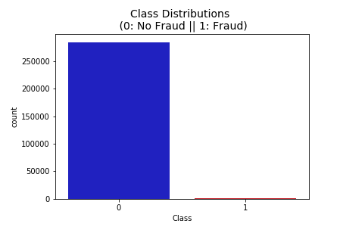
Fraud Detection - Dataset
Data set contains credit card transaction from EU in September 2013
The Dataset used is heavily unbalanced
No Frauds 99.83 % of the dataset
Frauds 0.17 % of the dataset
Contains only numerical input variables which are the result of a PCA transformation
Features V1, V2, … V28 are the principal components obtained with PCA
Time and Amount hasn’t been transformed

Slide 3
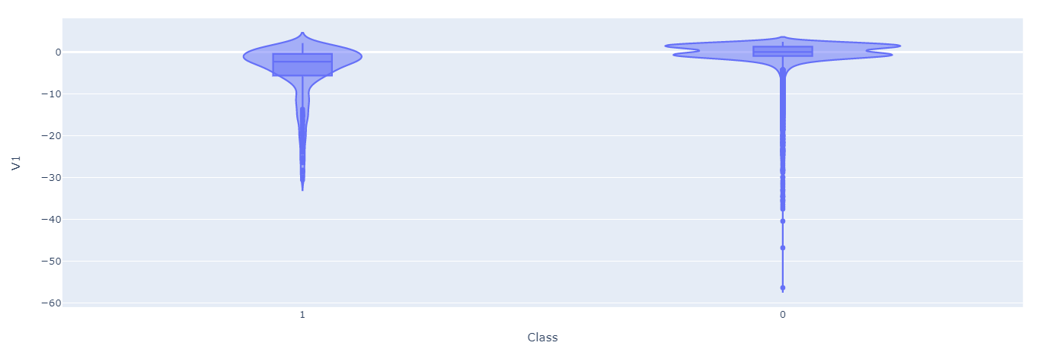
Fraud Detection - EDA
Dataset does not contain missing values
All feature have float64 data type only the label has type int64
Training set has 585 duplicates which has been dropped
Outliers dropped from the features

Slide 4
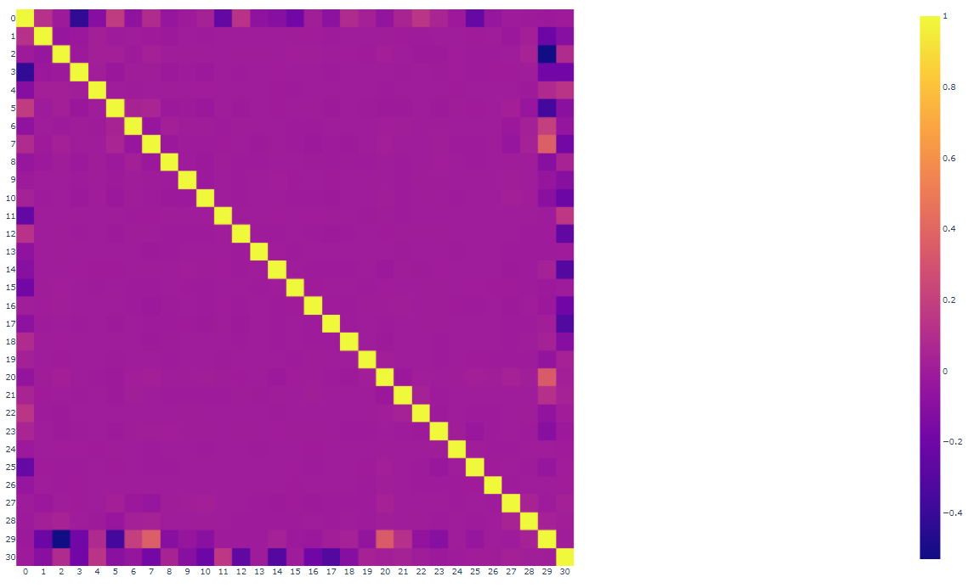
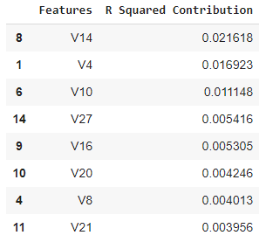
Fraud Detection - EDA
Correlation matrix shows that mot all the features have correlation with the labels
After statistical analysis only the following column are relevant
['V1', 'V4', 'V5', 'V7', 'V8', 'V9', 'V10', 'V13', 'V14', 'V16', 'V20', 'V21', 'V22', 'V24', 'V27', 'V28', 'Amount’]
From which the most relevant feature are in the table:

Slide 5
Fraud Detection – Model building
Approaches to model building with unbalanced dataset
Building various models
Classified with random forest and SVC
Oversampling is generation of new samples of the classes which are under-represented and there are various methodology to do it
Generation of the sample randomly
Generate new samples by interpolation
Undersampling algorithm will generate a new set S' where |S'| < |S| and S' \not\subset S
Prototype generation technique will reduce the number of samples in the targeted classes but the remaining samples are generated — and not selected — from the original set

Slide 6
Fraud Detection – Model evaluation
Accuracy of the model, it is misleading because especially for the unbalance dataset it can cause the Acuracy paradox
F1 Score is the 2((precisionrecall)/(precision+recall))
The F1 score conveys the balance between the precision and the recall.
The F1 Score is used to select a model based on a balance between precision and recall
The mean square error (MSE), The MSE it is interesting in how much the prediction deviates from the label,
but it is not a good measure for an unbalanced dataset as shown

Slide 7
Fraud Detection – Result discussion
Building various models
Random forest : F1 validation score: 83%, F1 Test score : 82%
SVC: F1 validation score: 79%
Oversampling
Generation of the sample randomly : F1 validation score: 81%
Generate new samples by interpolation:
F1 validation score: 81%
F1 Test score : 80%
Undersampling
F1 validation score: 0.001%

Slide 8
Thank you for the attention

